Slide 1
GridLAB-D Course Tutorial 3
Load modeling
David P. Chassin
Summer 2016
dchassin@stanford.edu
All registered trademarks are hereby recognized.

Slide 2
Outline of Tutorial
Collectors
Aggregating properties over groups of objects
Schedules and loadshapes
Driving properties using schedules
Load shape generation
Weather
Driving models using weather data
Residential loads
General house model with end-use loads and appliances

Slide 3
Collectors
Objects that record aggregate data
from groups of objects.

Slide 4
Output object
Implemented in tape and mysql modules
One of two primary ways of collecting data
Observes aggregates of properties over a group of objects
Several possible destinations for tape data
File : destination is a specially formatted files
ODBC : destination is an ODBC database
Memory : destination is a global variable

Slide 5
Group
Defines group criteria for objects
Basis over which aggregation is performed
Search only on init
Initial search result is reused after first search
→ Groups are constant over time
Search criteria use invariant properties of objects
Header properties: class, parent, rank, latitude, longitude, in_svc, out_svc, name, groupid
Example: group "class=house";
Can include multiple groupings
Example: group "class=house AND groupid=feeder1"

Slide 6
Property
Same as recorder, but with aggregators
count, min, max, avg, std, sum, prod, mean, var, kur, gamma
Parts used for complex values
real, imag, mag, ang, arg
Example: property "sum(power.mag)"

Slide 7
File
Similar rules to recorder object
Meaning differs based on filetype property
Format can be system specific
“/” are normally used; “\” allowed in Windows
File must be writeable
Path to file is not automatically created
Existing file are overwritten
Write failure is warned, but ignored

Slide 8
Interval
Determine the sampling interval for data
How often is aggregate recomputed?
Units are seconds
-1 means sample when aggregate changes
0 means sample each iteration

Slide 9
Limit
The maximum number of samples
How many times will I sample?
Limits the size of the output file
0 is default
0 means no limit
Similar to recorders, this will “drive” the simulation

Slide 10
Trigger
Specifies condition to start recording
Works only for first target property
Usual compare ops apply
Examples
“< 0” : starts recording when aggregate is negative
Once triggered, recording continues to limit

Slide 11
Example
object collector {
group "class=house AND groupid=feeder1";
property "sum(power.mag),avg(hvac_load.real)";
interval 3600;
limit 24;
}

Slide 12
Demo
// demo_2_4: collector for sum and average of real part of all lights in ten houses
module residential{
implicit_enduses NONE;
}
module tape;
clock {
timezone PST+8PDT;
starttime '2001-01-01 0:00:00 PST';
stoptime '2001-07-01 00:00:00 PST';
}
schedule light_demand {
* 1-3 * * * 0;
* 4-6 * * * 0.15;
* 7-19 * * * 0;
* 20-0 * * * .85;
}
object house:..10 {
cooling_setpoint 90 degF;
object lights {
shape "type: analog; schedule: light_demand; power: 1.1 kW";
};
}
object collector {
file theat_collector.csv;
group “class=lights”;
property sum(energy.real),avg(energy.real); // no spaces, use real part only
interval 3600;
limit 744;
}

Slide 13
Schedules and Loadshapes
Using loadshapes and schedules to drive models

Slide 14
Schedule Object
Implemented in gldcore (not an actual object)
One of three primary ways of inputting dynamic data (others are players and shapers)
Represent a recurring pattern of values over time
Minutes, hours, days, months, weekdays
Define when a value is used: minutes hours days months weekdays value
Sunday is both day 0 (actual Sunday) and day 7 (holiday)

Slide 15
Schedules values and blocks
Format of time specification: POSIX standard (similar to crontab format in UNIX)
* 12 * * * X # value is X every day from noon to 1:00 PM
* 12-15 * 1-4 * Y # value Y from noon to 3pm Jan thru Apr
* 15,18-5 * * 1-5 # M-F 3 to 4 pm and 6 pm to 5 am
Schedule blocks
Schedules blocks basis for normalization
Schedules blocks must be full (no gaps in time)
Size limitation of 63 nonzero unique values per block
Max number of 4 blocks

Slide 16
Schedule options
Behavior can be modified using block options
Normalization: values are rescaled within each block
"normal" : normalize by sum of unweighted values in block
"absolute" : normalize by sum of absolute values in block
"weighted" : normalize by sum of time-weight values in block
"non-zero" : ensure no zero values are present in block
"positive" : ensure no negative (or zero) values are present
"boolean" : ensure values are strictly Boolean
"interpolate" : values are interpolated over time
schedule demand {
weighted;
* 21-8 * * 1-5 1.2 # weekdays 9pm-9am, weeknights
* 9-20 * * 1-5 1.5 # weekdays 9am-9pm, weekdays
* * * * 6-0 0.8 # weekends, holidays
}

Slide 17
Example Schedule
schedule heating_schedule {
// winter weekdays
* 0-5 * 1-4,10-12 1-5 65; // sleep
* 6-8 * 1-4,10-12 1-5 70; // awake
* 9-17 * 1-4,10-12 1-5 60; // away
* 18-20 * 1-4,10-12 1-5 70; // awake
* 21-23 * 1-4,10-12 1-5 65; // sleep
// winter weekends
* 0-9;21-23 * 1-4,10-12 6-7 65; // sleep
* 10-20 * 1-4,10-12 6-7 70; // awake
// summer
* * * 5-9 * 60; // all summer
}

Slide 18
Schedule Implementation
There are two ways to use schedules
Schedule transformation
Available methods to define transformation
Linear mapping function (internal function)
Non-linear mapping function (external function)
Discrete-time transfer function (z-domain filter)
Drives property from the current value of the schedule
Loadshapes
Schedule alters energy or power of loadshape property

Slide 19
Schedule Transforms
Works like targeting a player to an object property
object house {
heating_setpoint heating_schedule*2+3;
}
Very limited valid linear operators
Only multiplication, addition, and subtraction.
Syntax and order are important!

Slide 20
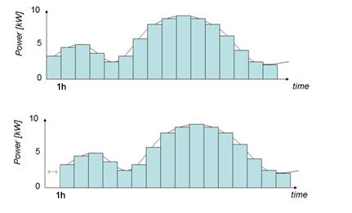
Schedule skew
One schedule can be skewed in time
Time skew differs for each object
Units of skew are in second
No unit conversion
object house {
schedule_skew 3600;
heating_setpoint heating_schedule;
}

Slide 21
Schedule caveats
Differences from the cron syntax:
Alternate day and weekday not supported
When both day and weekday given it is not "day or weekday"
Step by syntax (using /) is not supported.
Special keywords (e.g., @hourly, @daily) not supported
Weekday 7 refers to holidays the occur on weekday
Holidays are not supported yet, but will be someday
All times are considered in local time
Scheduled changes during daylight-savings/summer time (DST) shifts could result in a missing or duplicate value.

Slide 22
Load shapes
Property – loadshape
Special property type (pseudo-double)
Driven schedules
5 types
Analog
Pulsed
Modulated (un-validated)
Queued
Scheduled

Slide 23
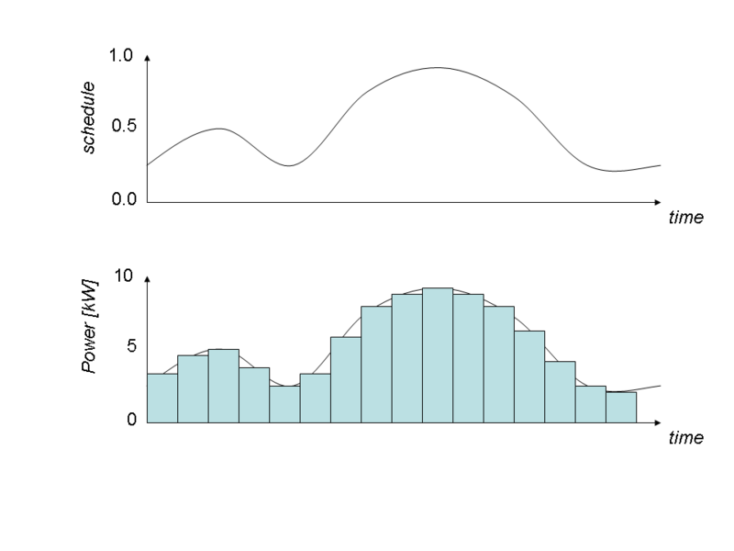
Analog Loadshapes
Directly compute power from values in the schedule
An analog loadshape is defined using one of the three following methods
class example {
loadshape myshape;
}
// Fixed scheduled energy in a block
object fixed-energy {
myshape "type: analog; schedule: schedule-name; energy: value kWh";
}
// Fixed power ( schedule value times the power value )
object scaled-power {
myshape "type: analog; schedule: schedule-name; power: value kW";
}
// Unscaled ( value in schedule is used directly )
object unscaled {
myshape "type: analog; schedule: schedule-name";
}

Slide 24
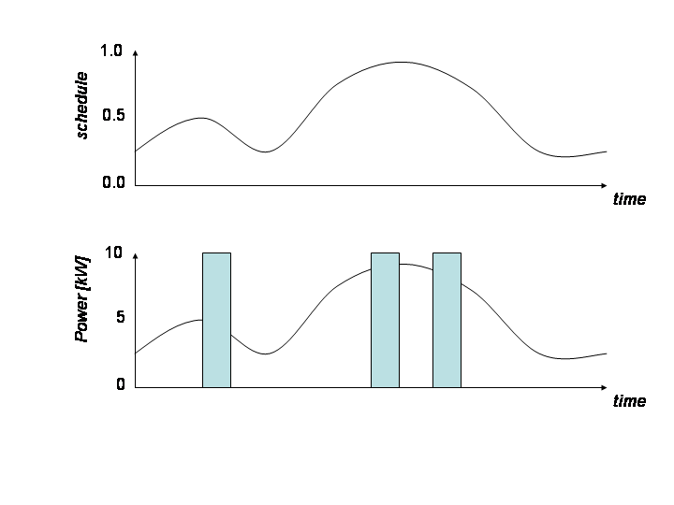
Pulsed
Emits pulses at random times
Total energy is define over the period of the loadshape.
A pulsed loadshape is defined using one of the two methods:
class example {
loadshape myshape;
}
// Constant pulse duration
object pulse-width {
myshape "type:pulsed; schedule:name; energy:value kWh; count:value; duration:value s";
}
// Constant pulse power
object pulse-amplitude {
myshape "type:pulsed; schedule:name; energy:value kWh; count:value; power:value kW";
}

Slide 25
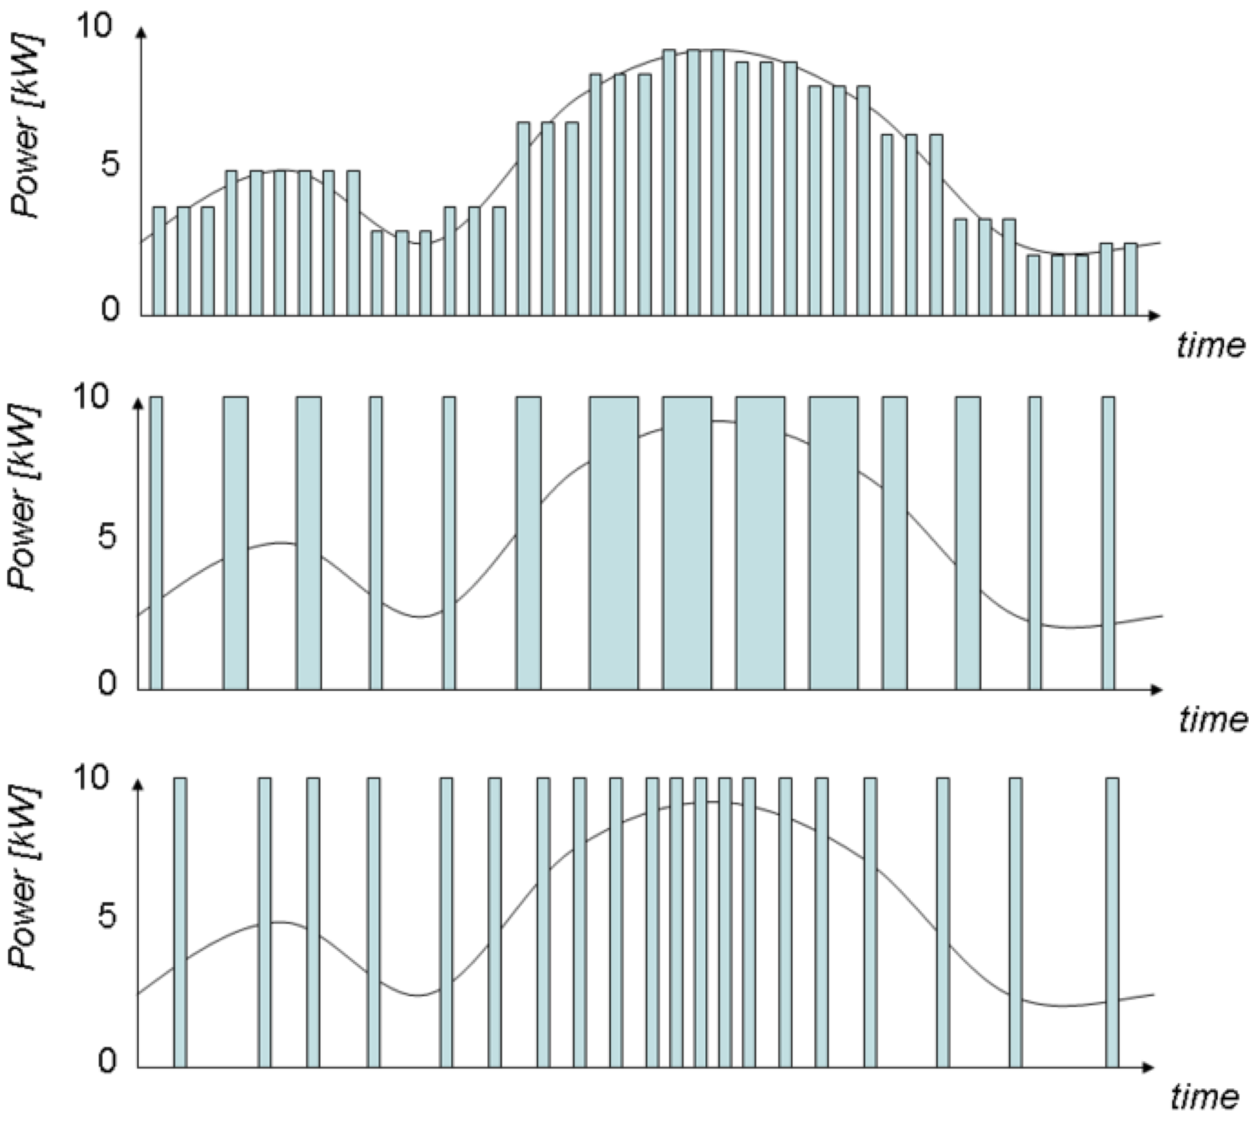
Modulated Loadshapes
Emit modulated pulses, 3 alternatives
constant period and duty-cycle (amplitude)
constant power and on-time (pulsewidth)
constant power and period (frequency).
Example:
class example {
loadshape name;
}
object sample {
myshape "type: modulated; modulation: amplitude; schedule: name; energy: value kWh; count: number; period: time s";
}
object sample {
myshape "type: modulated; modulation: pulsewidth; schedule: schedule-name; energy: value kWh; count: value; power: value kW";
}
object sample {
myshape "type: modulated; modulation: frequency; schedule: schedule-name; energy: value kWh; count: value; power: value kW";
}

Slide 26
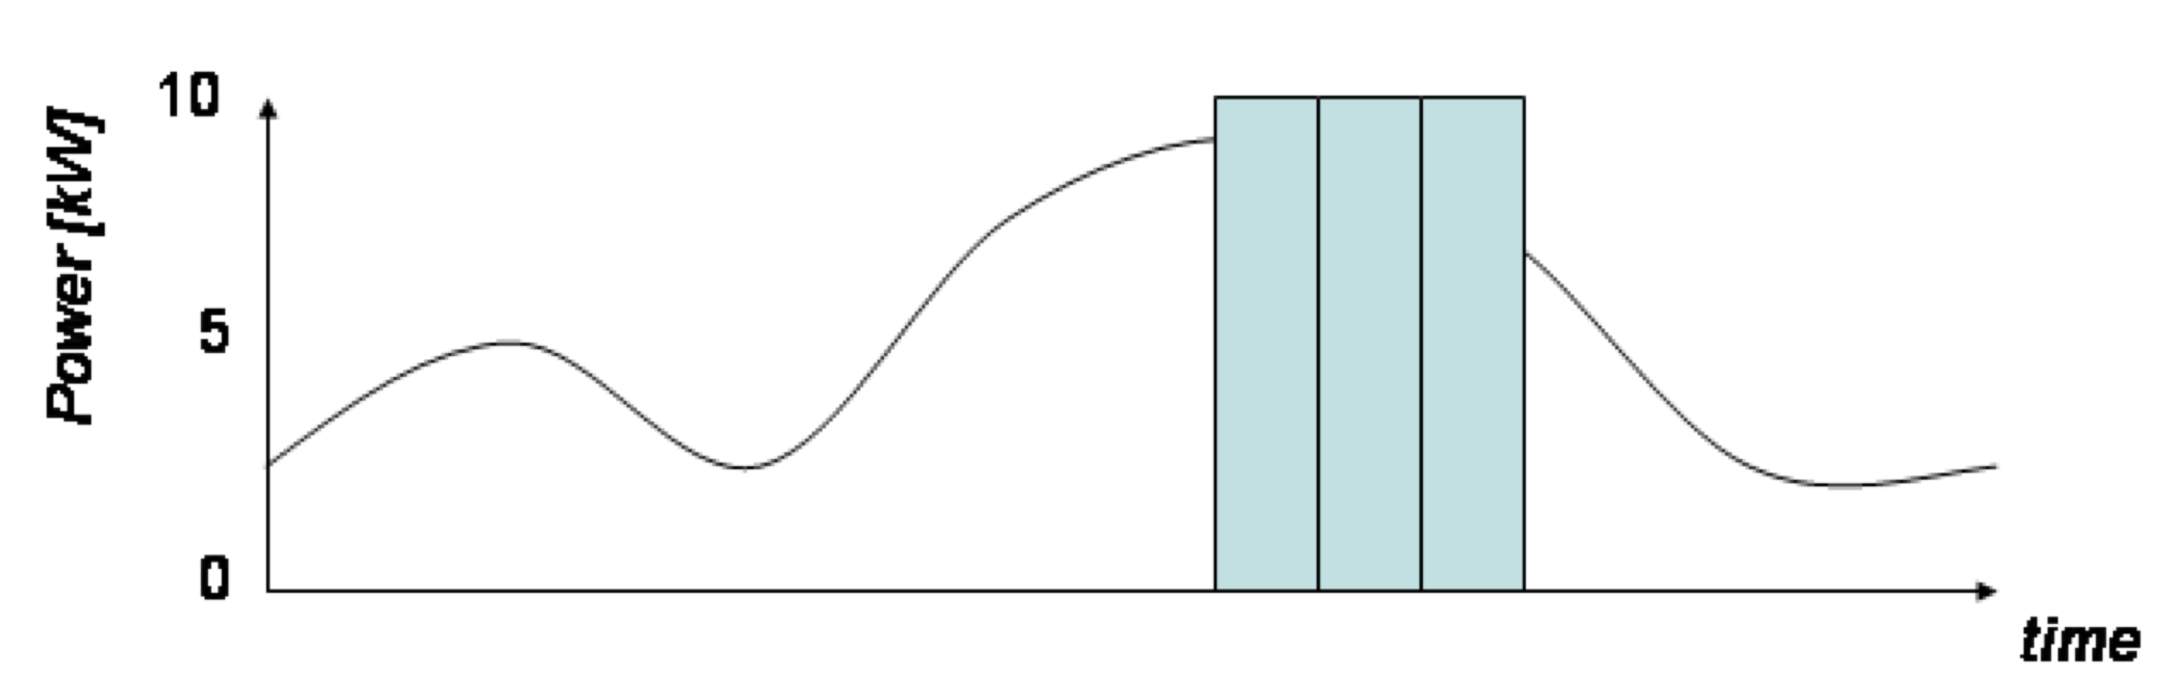
Queued Loadshapes
Random pulses when a queue
Accrues from the loadshape to a "on" threshold
Emitting pulses until queue reaches "off" threshold.
Examples:
class example {
loadshape myshape;
}
// Constant pulse duration
object sample {
myshape "type: queued; modulation: pulsed; schedule: schedule-name; energy: value kWh; count: value; duration: value s; q_on: value; q_off: value";
}
// Constant pulse power
object sample {
myshape "type: queued; modulation: pulsed; schedule: schedule-name; energy: value kWh; count: value; power: value kW; q_on: value; q_off: value";
}

Slide 27
Demo
// This demo uses a schedule for
// a plugload object and records the power demand and energy used
// by the object.
module tape;
module residential{
implicit_enduses NONE;
}
clock {
timezone PST+8PDT;
starttime '2001-01-01 00:00:00';
stoptime '2001-01-02 00:00:00';
}
schedule plug_shape {
* 0-2 * * * 0.15;
* 3-5 * * * 0.35;
* 6-8 * * * 0.70;
* 9-17 * * * 0.500;
* 18-20 * * * 0.86;
* 21-23 * * * 0.25;
}

Slide 28
Demo (cont.)
object house {
object plugload {
shape "type: analog; schedule: plug_shape; power: 1kW";
object recorder {
property power,demand,energy;
interval 3600;
limit 24;
file plugload_energy_usage.csv;
};
// Required to implement electrical properties – more detail later
power_factor 1.0;
power_fraction 1.0;
current_fraction 0.0;
impedance_fraction 0.0;
};
};

Slide 29
Questions?

Slide 30
Climate
Using weather data to drive models

Slide 31
Purpose of climate data
Many systems affected by weather
Loads, generators, lines, etc.
Several sources of weather data
Typical meteorological year (TMY)
NOAA weather records
Other weather station records
Be aware of issues with each source

Slide 32
TMY Data
Only source supplied with GridLAB-D
Some issues with long-term simulations
Months are seamed with discontinuities
Represent 12 different typical months, not a typical year
Data files are large
Default data type for climate files
Latitude, longitude, city, state loaded at init
Temperature, humidity, solar, and wind updated hourly for TMY2 data
Quadratic and Linear interpolations are supported
Does not drive simulation

Slide 33
Downloading TMY data
Repository at SourceForge
$SVN/code/data/
Only US cities are supported now
Files are zipped by state
Download process
Locate state zip file(s) in repository
Extract desired *.tmy2 file into working directory
Ok to extract entire ZIP for state in shared/gridlabd folder

Slide 34
CSV Reader
Allows user to import own weather data
Supports all variables currently used
Variables to be used are specified on first line:
temperature, wind_speed, etc.
First column is always the timestamp
Some syntax issues
Uses # for comments
Uses $ for state and city names and latitude and longitude specifications
No unit conversions
Does not support interpolations

Slide 35
Example CSV Reader
#sample weather CSV file
# timestamp format is "month:day:hour:minute:second"
# reads left to right - m:d:h is assumed if only 3 values
$state_name=California
$city_name=Berkeley
temperature,humidity
01:01:04, 50, 0.05 // Jan 1 4am temp=50, humidity=0.05
01:01:08, 62, 0.16 // Jan 1 8am temp=62, humidity=0.16
01:01:13, 78, 0.12 // Jan 1 1pm temp=78, humidity=0.12
01:01:20, 70, 0.10 // Jan 1 8pm temp=70, humidity=0.10
01:02:02, 51, 0.06 // Jan 2 2am temp=51, humidity=0.06

Slide 36
Climate class parameters
class climate {
char32 city;
char1024 tmyfile;
double temperature[degF];
double humidity[%];
double solar_flux[W/sf]; // 9 orientations
double wind_speed[mph];
double wind_dir[deg];
double wind_gust[mph];
double record.low[degF];
double record.high[degF];
double record.solar[W/sf];
enum interpolate; //NONE (default), LINEAR, QUADRATIC
}

Slide 37
Examples
// Example 1: Using tmy2 data
object climate {
tmyfile "name_of_file.tmy2";
}
// Example 2: Using a csv file
object csv_reader {
name "reader-name";
filename "name_of_file.csv";
}
object climate {
tmyfile "name_of_file.csv";
reader "reader-name";
}

Slide 38
Questions?

Slide 39
Residential buildings
Modeling residential building loads

Slide 40
Two kinds of models
House E (ETP)
Class name is "house"
Based on equivalent thermal parameters (ETP) model
Second-order model (include single thermal mass effects)
Appliance models included in module
Built-in appliance (explicit) or load shapes/enduses (implicit)
Explicit models
Some use performance models
Others use physical/state-space models
Note: House A (ASHRAE) is deprecated but still in code

Slide 41
House Object
Has two main functions
Determines state and power consumption of the HVAC system (ETP Model)
Accumulates effects of residential appliances
Attaches to the power system via a triplex_meter
Triplex_meter must be parent of house
Absent the meter, voltage source is static 120/240 V
Uses climate object for weather data

Slide 42
Physical vs. Implicit Models
Only HVAC and waterheater currently incorporate physical models
Use physical parameters to compute state
Mainly used for thermostatic control studies
Dryer, dishwasher, electric range, clothes washer, and refrigerator models are fully developed performance models
Freezer and microwave are experimental models
Evcharger is a probabilistic model
Not all appliances use residential enduse loadshapes
Some use time varying ZIP models

Slide 43
Equivalent Thermal Parameters (ETP)
Two-node lumped-parameter model
Over-damped DC circuit – exponential decay
Simple enough for direct analytic (not numerical) solution & fast computation
Complex enough to capture building load shapes
Accounts for weather, building thermal properties, solar & internal gains, thermostat settings
Heat added by HVAC system + internal (appliances) + solar
Internal gains driven by time-of-day, day-of-week schedule
Solar gains from weather & window properties
Split between air & mass nodes
HVAC capacity & COP depend on outdoor temperature
QHVAC-electric = CapacityThermal / COP

Slide 44
Heat Balance Equations Solved
Heat balance for the air temperature node (TA):
0 = QA - UA (TA – TO) - HM (TA – TM) - CA dTA/dt
Heat balance for the mass temperature node (TM):
0 = QM - HM (TM – TA) - CM dTM/dt
Solution is second-order differential equation
Slow pole for longer mass effects (affects mid-term DR)
Fast term for shorter mass effects (affects H/C cycling)
GridLAB-D solves ETP only when needed

Slide 45
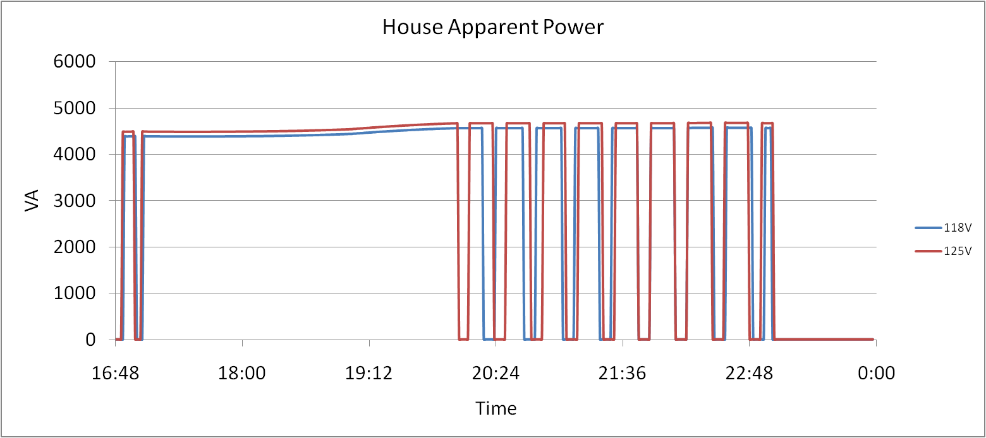
Physical Load Model – Residential HVAC

Slide 46
House design parameters
object house {
// Physical design parameters – all default to ‘reasonable’ values from floor area
double floor_area[sf];
double gross_wall_area[sf];
double ceiling_height[ft];
double aspect_ratio;
double window_wall_ratio;
double number_of_doors;
double exterior_wall_fraction;
double interior_exterior_wall_ratio;
double exterior_ceiling_fraction;
double exterior_floor_fraction;
double number_of_stories;
double Rroof[degF];
double Rwall[degF];
double Rfloor[degF];
double Rwindows[degF];
double Rdoors[degF];
double window_shading;
double window_exterior_transmission_coefficient;
…

Slide 47
HVAC design parameters
object house {
// HVAC design parameters – all default to ‘reasonable’ values from floor area
// Some values are extracted from climate data
double cooling_design_temperature[degF];
double heating_design_temperature[degF];
double design_peak_solar[Btu/h];
double design_internal_gains[W/sf];
double cooling_supply_air_temp[degF];
double heating_supply_air_temp[degF];
double duct_pressure_drop[in];
double heating_COP[pu];
double cooling_COP[Btu/kWh];
double design_heating_capacity[Btu/h];
double design_cooling_capacity[Btu/h];
double design_heating_setpoint[degF];
double design_cooling_setpoint[degF];
double auxiliary_heat_capacity[Btu/h];
double over_sizing_factor[unit];
…

Slide 48
Heatflow parameters
object house {
// These values define the flow of heat from incident solar, air, and mass
double solar_heatgain_factor;
double airchange_per_hour;
double internal_gain[Btu/h];
double solar_gain[Btu/h];
double incident_solar_radiation[Btu/h];
double heat_cool_gain[Btu/h];
double air_heat_fraction[pu];
double mass_heat_capacity[Btu/degF];
double mass_heat_coeff[Btu/degF];
double air_heat_capacity[Btu/degF];
double total_thermal_mass_per_floor_area[Btu/degF];
double interior_surface_heat_transfer_coeff[Btu/h];
double design_internal_gain_density[W/sf];
…

Slide 49
Fan and Motor parameters
object house {
// Fan design parameters default to reasonable values from HVAC designs
double fan_design_power[W];
double fan_low_power_fraction[pu];
double fan_power[kW];
double fan_design_airflow[cfm];
double fan_impedance_fraction[pu];
double fan_power_fraction[pu];
double fan_current_fraction[pu];
double fan_pow
double hvac_motor_efficiency[unit];
double hvac_motor_loss_power_factor[unit];er_factor[pu];
…

Slide 50
Thermostat parameters
object house {
// These parameters control the operation of the thermostat
double heating_setpoint[degF];
double cooling_setpoint[degF];
double aux_heat_deadband[degF];
double aux_heat_temperature_lockout[degF];
double aux_heat_time_delay[s];
double thermostat_deadband[degF];
int16 thermostat_cycle_time;
timestamp thermostat_last_cycle_time;
int64 last_mode_timer;
…

Slide 51
Derived parameters
object house {
// These parameters are all derived from others, or calculated over time
double air_temperature[degF];
double outdoor_temperature[degF];
double mass_temperature[degF];
double air_volume[cf];
double air_mass[lb];
double latent_load_fraction[pu];
double heating_demand;
double cooling_demand;
double envelope_UA[Btu/degF];
double airchange_UA[Btu/degF];
…

Slide 52
Load parameters
object house {
// These parameters translate appliance operations into electrical demand
enduse panel;
complex panel.energy[kVAh];
complex panel.power[kVA];
complex panel.peak_demand[kVA];
double panel.heatgain[Btu/h];
double panel.heatgain_fraction[pu];
double panel.current_fraction[pu];
double panel.impedance_fraction[pu];
double panel.power_fraction[pu];
double panel.power_factor;
complex panel.constant_power[kVA];
complex panel.constant_current[kVA];
complex panel.constant_admittance[kVA];
double panel.voltage_factor[pu];
double panel.breaker_amps[A];
double hvac_breaker_rating[A];
double hvac_power_factor[unit];
double hvac_load;
double total_load;
…

Slide 53
Enumerations
object house {
// Various enumerations that define different aspects of home, * is default value
enum heating_system_type; //RESISTANCE, *HEAT_PUMP, GAS, NONE
enum cooling_system_type; //HEAT_PUMP, ELECTRIC, *NONE
enum auxiliary_system_type; //ELECTRIC, *NONE
enum auxiliary_strategy; //LOCKOUT, TIMER, DEADBAND, NONE
enum fan_type; //TWO_SPEED, *ONE_SPEED, NONE
enum thermal_integrity_level; // VERY_GOOD, GOOD, ABOVE_NORMAL,
// NORMAL, BELOW_NORMAL, LITTLE, VERY_LITTLE, *UNKNOWN
enum glass_type; //*LOW_E_GLASS, GLASS, OTHER
enum window_frame; //INSULATED, WOOD, *THERMAL_BREAK, ALUMINUM, NONE
enum glazing_treatment; //HIGH_S, LOW_S, REFL, ABS, *CLEAR, OTHER
enum glazing_layers; //THREE, *TWO, ONE, OTHER
enum motor_model; //FULL, BASIC, *NONE
enum motor_efficiency; //VERY_GOOD, GOOD, *AVERAGE, POOR, VERY_POOR
…

Slide 54
“Easy” House – Major Parameters
object house {
}
object house {
floor_area 2500;
}
object house {
floor_area 2500;
thermal_integrity GOOD;
cooling_setpoint 72;
heating_setpoint 65;
}
object house {
floor_area 2500;
Rwall 19;
Rroof 30;
Rfloor 22;
Rdoors 5;
Rwindows 2.1;
airchange_per_hour 0.5;
number_of_stories 1;
cooling_setpoint 72;
heating_setpoint 65;
cooling_system_type ELECTRIC;
heating_system_type HEAT_PUMP;
auxiliary_system_type ELECTRIC;
}

Slide 55
Implicit Models Residential Enduse
All residential objects can be used as a residential enduse
Uses any of four available loadshapes (analog, pulsed, modulated, queued)
Overrides physical state driven models, but certain variables are still used (e.g. placement still determines the where the heatgain goes)
By default, all appliances are turned on as residential enduses
Certain appliances may be turned on, or all of the turned off
module residential {
implicit_enduses NONE;
// or
implicit_enduses LIGHTS|PLUGS;
}

Slide 56
Residential Enduse
object lights {
// User assigned values. Lights are only used as an example.
double power_factor[unit];
double heatgain_fraction[pu];
double installed_power[kW];
double impedance_fraction[pu];
double current_fraction[pu];
double power_fraction[pu];
loadshape shape;
double breaker_amps[A];
// Automatically updated values
double heatgain[Btu/h];
complex power[kVA];
complex energy[kVAh];
complex peak_demand[kVA];
double voltage_factor[pu];
double constant_current[kVA];
double constant_power[kVA];
double constant_impedance[kVA];
}

Slide 57
Residential Enduse (example)
class lights {
loadshape myshape;
}
object lights {
myshape "type: analog; schedule: schedule-name; energy: value kWh";
installed_power 1 kW;
power_factor 0.95;
impedance_fraction 1.0;
power_fraction 0.0;
current_fraction 0.0;
placement INDOOR;
}

Slide 58
Available Appliances
Waterheater
Lights
Refrigerator
Clotheswasher
Dishwasher
Plugs
Microwave
Range
Freezer
Dryer
Evcharger
Occupants

Slide 59
Waterheater (physical model)
The water heater simulation uses two very different models depending on the state of the tank at any given moment. They are:
One-Node Model:
Simple, lumped-parameter: tank is at uniform temperature
Computes time required to change temperature of entire mass
Two-Node Model:
Two waster masses, each at different uniform temperature
Upper “hot” node near the set point temperature
Lower “cold” node is between inlet temperature and setpoint
Computes motion of thermocline as heat is added/removed

Slide 60
Waterheater (physical model)
class waterheater {
double tank_volume[gal];
double tank_UA[Btu/h];
double tank_diameter[ft];
double water_demand[gpm];
double heating_element_capacity[kW];
double inlet_water_temperature[degF];
enumeration heat_mode; //GASHEAT, ELECTRIC
enumeration location; //GARAGE, INSIDE
double tank_setpoint[degF];
double thermostat_deadband[degF];
double temperature[degF];
double height[ft];
double actual_load[kW];
}

Slide 61
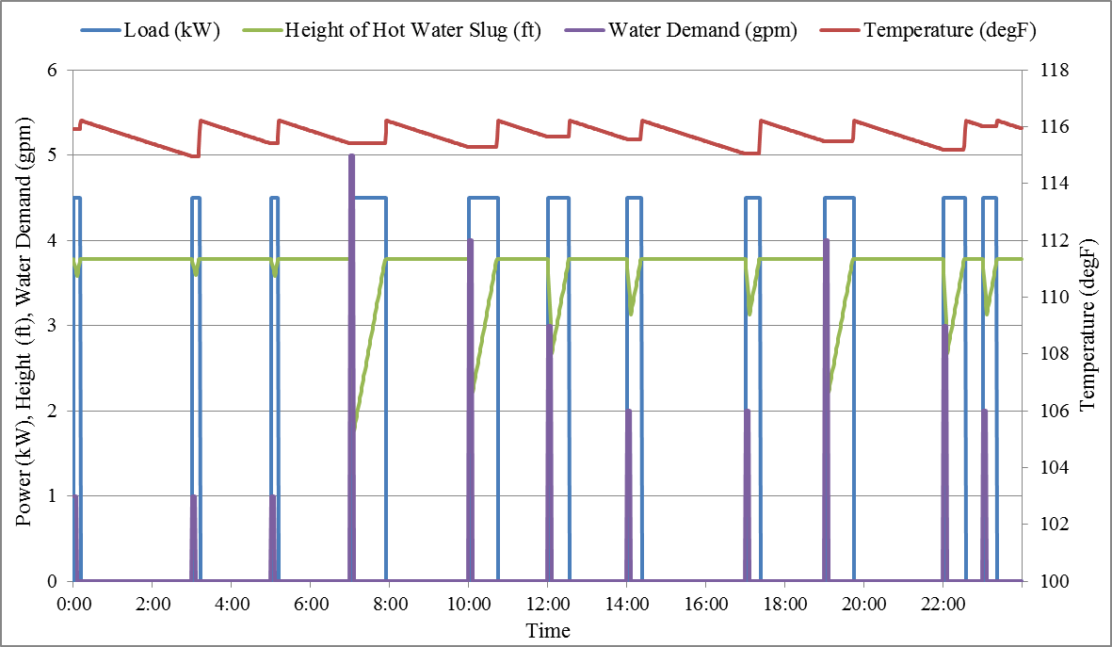
Waterheater (physical model)

Slide 62
Dishwasher
object dishwasher {
double energy_baseline [kWh];
bool Heateddry_option_check;//// true or false
double control_power [W];
double motor_power [W];
double dishwasher_coil_power_1 [W];
double dishwasher_coil_power_2 [W];
double dishwasher_coil_power_3 [W];
double daily_dishwasher_demand DISHWASHER;
double queue;
double queue_min;
double queue_max;
};

Slide 63
Dishwasher
Variables | Values
energy_baseline | 0.9kWh
Heateddry_option_check | true
control_power | 10W
motor_power | 250W
dishwasher_coil_power_1 | 580W
Variables | Values
dishwasher_coil_power_2 | 695W
dishwasher_coil_power_3 | 950W
queue | 1
queue_min | 0
queue_max | 2

Slide 64
Dryer
object dryer {
double energy_baseline [kWh];
double controls_power [W];
double motor_power [W];
double dryer_coil_power [W];
double daily_dryer_demand DRYER;
double queue;
double queue_min;
double queue_max;
};

Slide 65
Dryer
Variables | Values
energy_baseline | 3.0kWh
controls_power | 10W
motor_power | 200W
dryer_coil_power | 5800W
queue | 0.8
queue_min | 0
queue_max | 2

Slide 66
Range
object range {
//Oven
double oven_volume [gal];
double heating_element_capacity [Kw];
double oven_setpoint [degF];
double temperature [degF];
double thermostat_deadband [degF];
enumeration location; //GARAGE, INSIDE
double oven_UA [Btu.h/degF];
double food_density [lb/cf] ;
double specificheat_food [Btu/lb.degF];
double time_oven_setting [s];
double queue_oven;
double demand_oven RANGE;
double oven_demand;

Slide 67
Range
//cooktop
double cooktop_energy_baseline [kWh];
double cooktop_coil_setting_[kW];
double cooktop_coil_setting_2 [kW];
double cooktop_coil_setting_3 [kW];
double cooktop_interval_setting_1 [s];
double cooktop_interval_setting_2 [s];
double cooktop_interval_setting_3 [s];
double time_cooktop_setting [s];
double demand_cooktop RANGE;
double queue_cooktop;
double queue_min;
double queue_max;
};

Slide 68
Range (Oven)
Variables | Values
oven_volume | 5
heating_element_capacity | 1kW
oven_setpoint | 150degF
temperature | 70degF
thermostat_deadban | 8degF
location | INSIDE
Variables | Values
oven_UA | 2.9
food_density | 5
specificheat_food | 1
time_oven_setting | 3600s
queue_oven | 0.85

Slide 69
Range (Cook top)
Variables | Values
cooktop_energy_baseline | 0.5 kWh
cooktop_coil_setting_1 | 2kW
cooktop_coil_setting_2 | 1.0kW
cooktop_coil_setting_3 | 1.7kW
cooktop_interval_setting_1 | 240s
Variables | Values
cooktop_interval_setting_2 | 900s
cooktop_interval_setting_3 | 120s
Queue_cooktop | 0.99
queue_min | 0
queue_max | 2

Slide 70
Refrigerator
object refrigerator {
double door_opening_criterion REFRIGERATOR;// ELCAP
double daily_door_opening;
enumeration state; // COMPRESSSOR_OFF_NORMAL
double energy_used [kWh];
enumeration defrost_criterion;// DOOR_OPENINGS
double delay_defrost_time [s];
double door_opening_criterion;
};

Slide 71
Refrigerator
Variables | Values
door_opening_criterion | REFRIGERATOR
daily_door_opening | 20
state | COMPRESSSOR_OFF_NORMAL
energy_used | 13.5kWh
defrost_criterion | DOOR_OPENINGS
delay_defrost_time | 600s
door_opening_criterion | 24

Slide 72
Clotheswasher
object clotheswasher {
double queue;
double demand CLOTHESWASHER;//ELCAP
enumeration state// STOPPED
double queue_min;
double queue_max;
};

Slide 73
Clothes washer
Variables | Values
queue | 1.7
state | STOPPED
queue_min | 0
queue_max | 2

Slide 74
Lights
class lights {
// In addition to residential enduse variables
enumeration type; //HID, SSL, CFL, FLUORESCENT, INCANDESCENT
enumeration placement; // OUTDOOR, INDOOR
double installed_power[kW];
double circuit_split; // -1=100% on 1 … +1=100% on 2
double demand[unit]; // fraction that is on
double power_density[W/sf];
complex actual_power[kVA]; //actual power consumption
}

Slide 75
Plugs
class plugload { // In addition to residential enduse variables
double circuit_split;
double demand[unit];
double installed_power[kW];
complex actual_power[kVA];
}

Slide 76
Occupants
class occupantload {
int32 number_of_occupants;
double occupancy_fraction[unit];
double heatgain_per_person[Btu/h];
}

Slide 77
Microwave
class microwave {
// Note: This object is not fully operational.
double installed_power[kW];
double standby_power[kW];
double circuit_split;
double cycle_length[s];
enumeration state; //ON, OFF
double runtime[s];
double state_time[s];
}

Slide 78
Freezer
class freezer {
// Note: This object is not fully operational.
double size[cf];
double rated_capacity[Btu/h];
double temperature[degF];
double UA[Btu.h/degF];
double deadband[degF];
double setpoint[degF];
}

Slide 79
Zipload
class ZIPload {
// In addition to residential enduse variables
double heat_fraction;
double base_power[kW];
double power_pf;
double current_pf;
double impedance_pf;
double breaker_val[A];
double is_240; //true or false
complex actual_power[kVA];
}
Generic load model that allows adjustment of all power factors and zip fractions.
Only uses enduse structure (no state model).

Slide 80
Distribution panel
Appliances are automatically assigned to circuits
configuration IS220 flags that load is on a 220V circuit
110V loads are placed on alternative circuits
Provides for automatic load balancing
Implements general protection from overvoltage
Each circuit has a breaker with appropriate Amp limit
Entire house also has an Amp limit
Breakers have a limit on number of operation

Slide 81
Exercises
Collect total power consumption for a population of 100 water heaters for one month Hint: use “actual_load”.
Collect the hourly average, stdev, minimum and maximum indoor air temperature a population of 100 default houses for a week Hint: use “air_temperature”.
Collect the minimum and maximum voltages of all nodes in the IEEE 37-bus test model as it converges; Hint: use voltage_A.mag, voltage_B.mag, & voltage_C.mag

Slide 82
Exercises
Define a house with this load shape and record the house plug load.
Define a second house using the same plug load shape but make it pulsed
W
750
500
250
0
0
3
6
9
12
15
18
21
24
hr

Slide 83
Exercises
Create a climate object that uses Yakima WA tmy2 data. Record the weather data every ten minutes.
Repeat Exercise 1, using QUADRATIC and LINEAR interpolations and record at ten minute intervals.
Create a climate object that uses the sample csv reader (weather.csv). Record the weather data every hour.

Slide 84
Exercises
Create a house object with all end-uses implemented and plot the power output for a winter week and a summer week.
Using the same model, plot the indoor temperature for a winter week and a summer week.
Modify the same house to only contain the HVAC and a zipload object that is driven by a schedule transform (no enduses).
Record the power output over time.
Modify the ZIP fractions, and observe the difference.
Create a house with two water heaters.
Make the first waterheater a physical model
Make the second driven by a load_shape.
Compare power output from the water heaters.
Hint: use a schedule transform for the first and use “loadshape myshape” with “water_demand this.myshape” for the second.

